Slide 1
FYP5: Object Detection, Tracking and Suspicious Activity Recognition for Maritime Surveillance using Thermal Vision

Slide 2
Weekly Tasks
Continue working on the mechanical platform design using Solidworks and performing necessary calculations.
Developing and simulating multiple platform designs.
Getting ahead with activity recognition.
Improving the developed control system.

Slide 3
Deep Learning Analysis of Video Data
Video Analysis
Localizes in time
Activity Detection
Localization
Does not localize in time
Activity Recognition
Information Used
Only Time
Temporal
Time and Space
Spatio-Temporal
Future information
Offline
Only past and present
Online
3D Networks
2-Stream Networks
LSTM
Object Detection
Object Tracking

Slide 4
Proposed Network Pipeline
Camera
Only Temporal
Action Prediction
Fusion
Feature Extractor
Object Detection
Present Frame
Temporal & Spatial
Tube Generation
Fusion
Optical Flow
Feature Extractor
Object Detection
Object Tracking

Slide 5
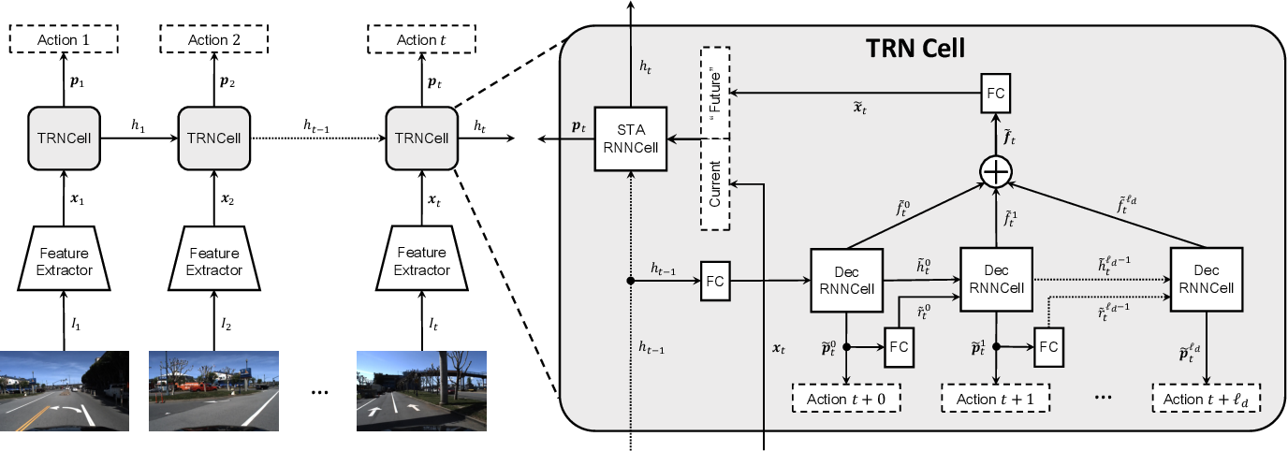
Proposed Activity Detection Network Online Temporal Localization
Xu, Mingze, et al. "Temporal recurrent networks for online action detection." Proceedings of the IEEE International Conference on Computer Vision. 2019.

Slide 6
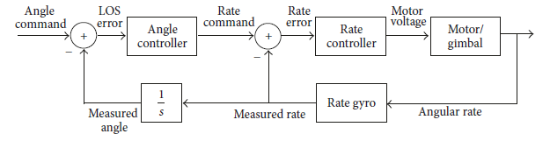
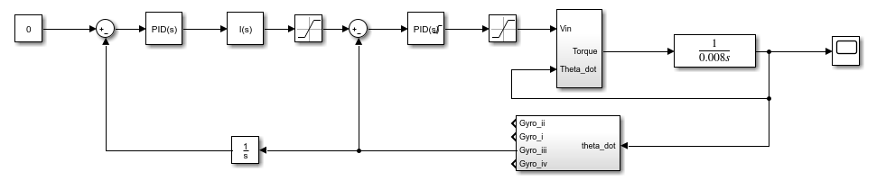
Control System

Slide 7
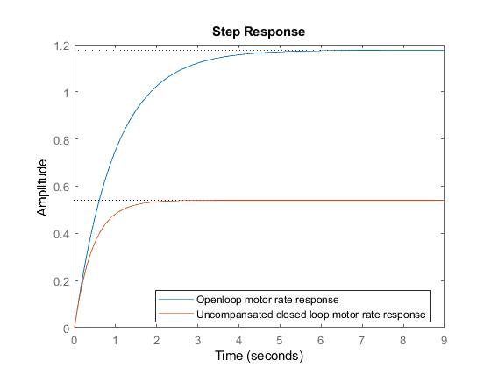
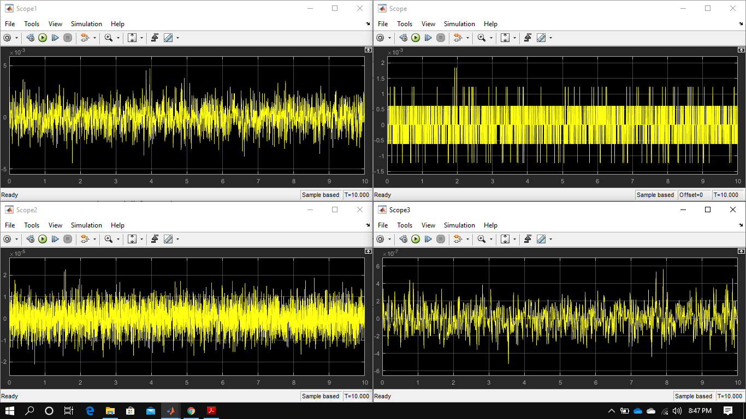
Zero Rate gyro Simulation
Motor rate response

Slide 8
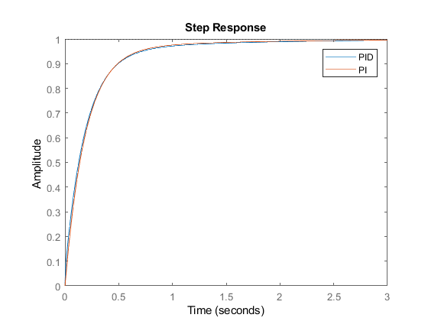
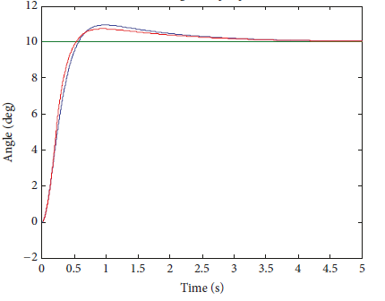

PID vs PI performance in motor controller loop
PID vs PI² performance in Angle controller loop

Slide 9
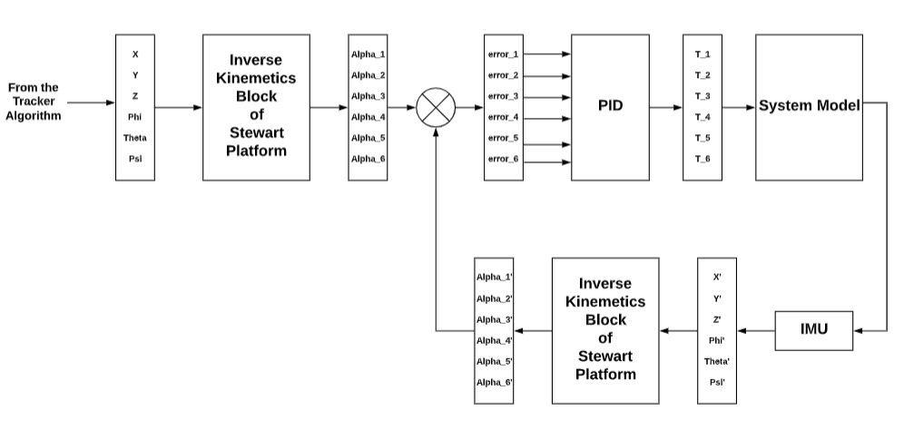
PID control of Stewart Platform
error_i = Alpha_i – Alpha_i' for i = 1,2,…..,6
Each error term is multiplied by PID constants and results in the necessary Torques for each of the motors.

Slide 10
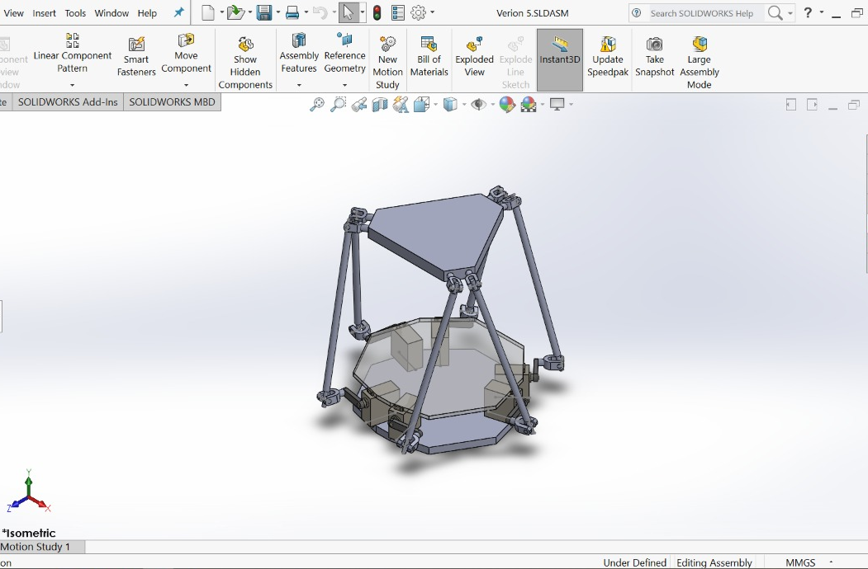
Developed Stewart Platform

Slide 11
Analysis on Servo Motors
Based on
RPM
Torque
Weight
Dimensions
Operating Voltage
Dead Bandwidth
https://drive.google.com/open?id=1FkmcclzX62q9hdmabhoDzJuPEYJdhCRd

Slide 12

Tasks for next week
Activity Detection
Simulation (If possible)

